Slide 1
CONCEPTUAL DESIGN
APHELION MUSIC
MUSIC GENRE CLASSIFIER

Slide 2
STEP 1
STEP 2
STEP 3
STEP 4
STEP 5
We have to download the GTZAN Dataset which is popular for Music Genre Classification
Next we need to extract the MFCC features from the dataset and store it in a .json file so that we can use this for training our ML models
Try out a couple of models namely: ML (kNN, SVM, random forest etc.), RNN, ANN,LSTM and CNN.
Independently check each model performance and save the best model.
Program is tested for all the inputs as well as unit test is incorporated into the modelling and program
User interface program is created which user the user will interact with. It will classify any song provided by the user

Slide 3
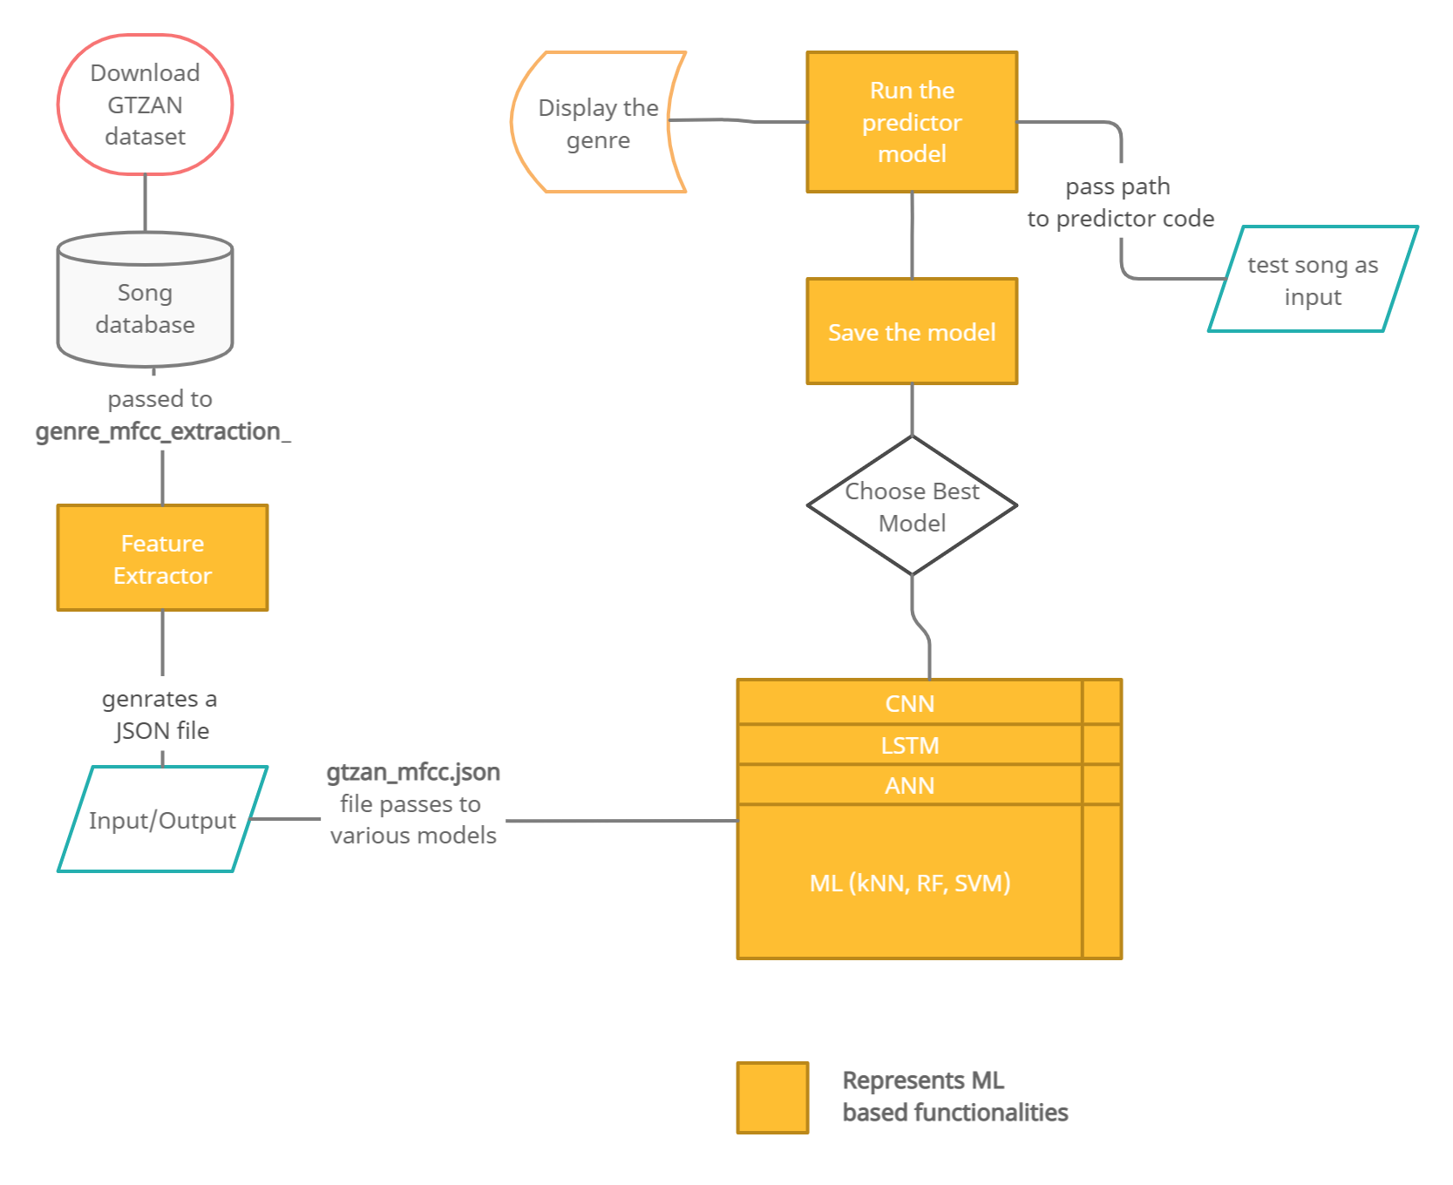
Project High-Level Planning

Slide 4
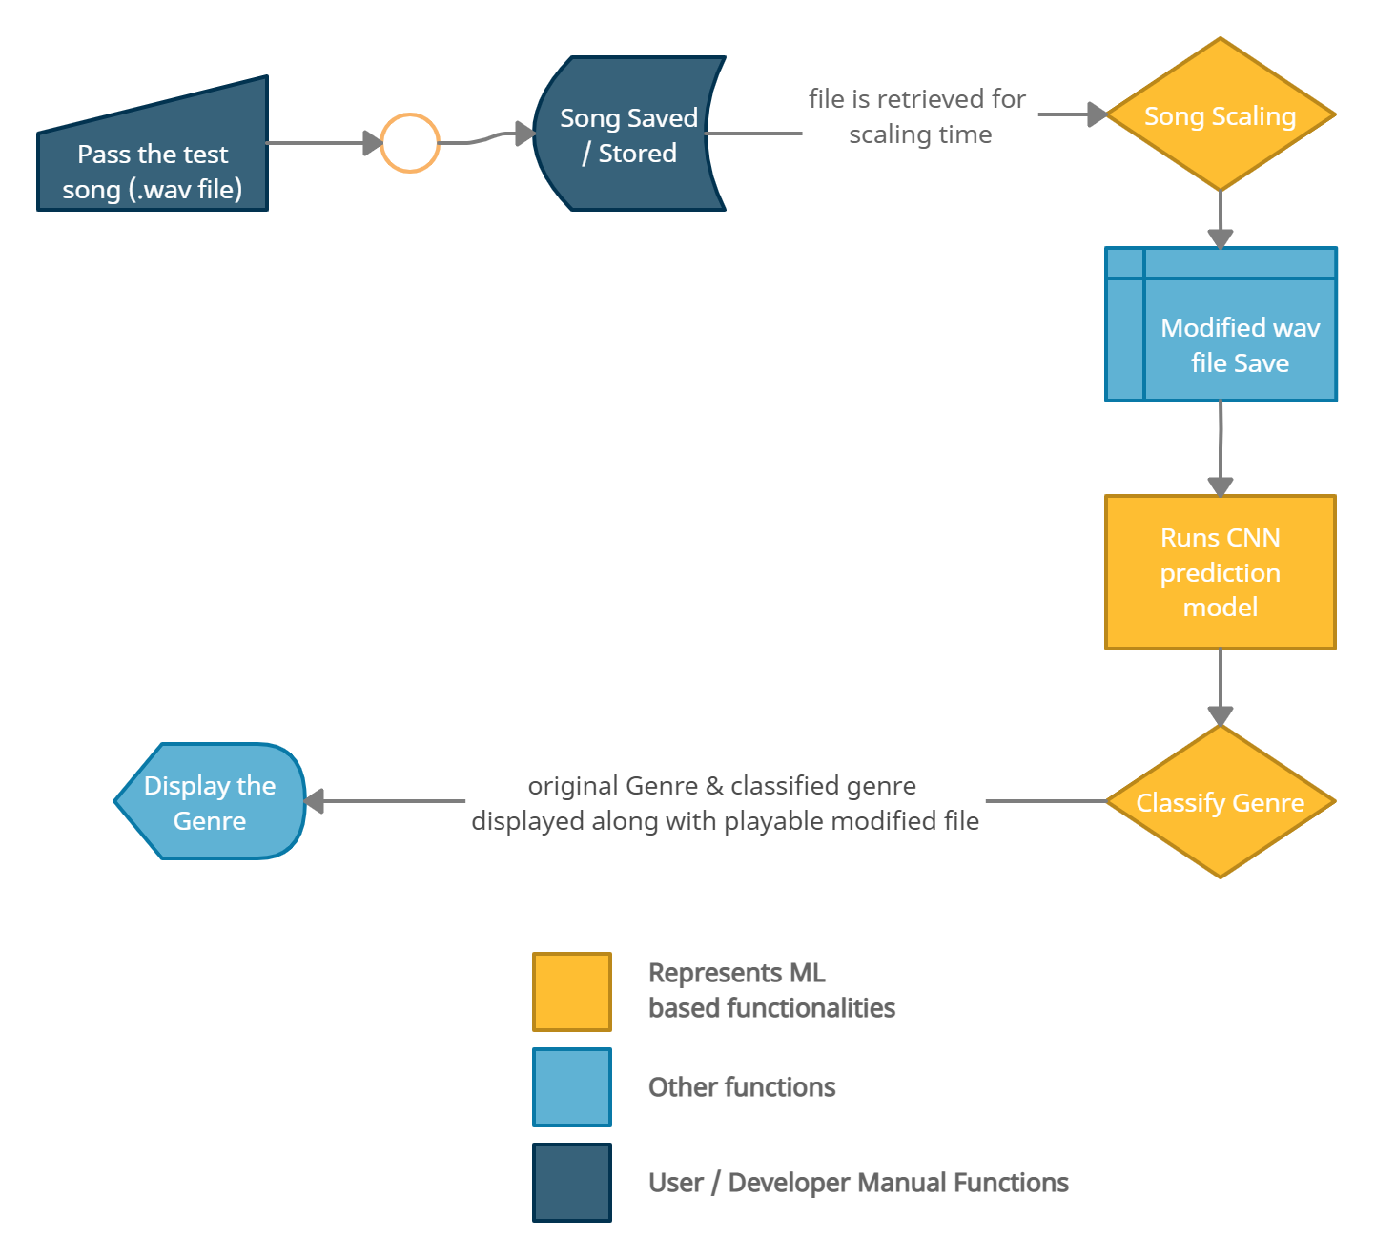
High-Level User / Developer Interface

